Slide 1
Predictive Maintenance for Vehicle Engines Using Machine Learning and Real-Time Sensor Data
Here is where your presentation begins

Slide 2
Team Members
NAME | REGISTRATION NUMBER
S. DURGA SAI SRIRAM | 99210041287
T. AMRUTHA | 9921004728
SK. TABASUM JAHA | 99210041685
R. SANDEEP | 9921004970
Team No - 228
MENTOR: DR. P PANDI SELVAM

Slide 3
Scope Of The Project
Develop a machine learning model to predict vehicle engine conditions based on sensor data (e.g., RPM, oil pressure, temperatures).
Build an interactive Streamlit web app for real-time engine condition predictions using user-provided sensor inputs.
Target vehicle maintenance professionals and fleet managers, aiming to reduce downtime and optimize repair schedules through proactive maintenance insights.

Slide 4
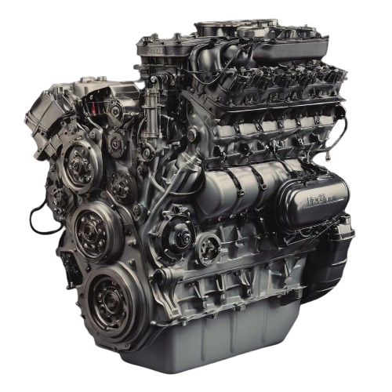
Problem Statement
The problem statement involves creating an AI system that continuously monitors vehicle health in real-time by analyzing live sensor data. This system aims to predict potential issues, visualize performance trends, and provide timely alerts to ensure proactive maintenance and optimal vehicle management.

Slide 5
Relevance
Operational Efficiency: By moving from reactive or scheduled maintenance to predictive maintenance, vehicle downtime can be minimized, leading to better asset utilization.
Fleet Management Needs: The growing complexity of fleet operations demands smarter solutions for managing vehicle health.
Sustainability: Improved maintenance strategies can prolong vehicle life, contributing to resource efficiency and environmental conservation.

Slide 6
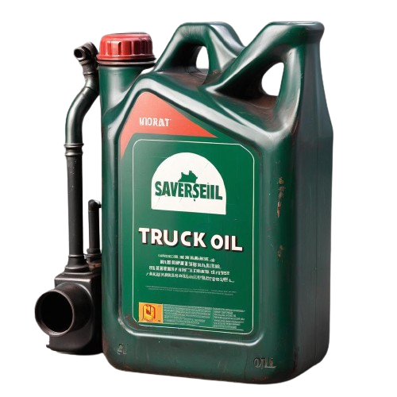
Objective
To create a real-time engine maintenance system using live sensor data and advanced algorithms to predict issues, visualize performance, and enable cost-effective fleet management with timely alerts.
This approach helps in optimizing maintenance schedules and managing fleet costs effectively by addressing issues proactively.

Slide 7
Technical Feasibility
Data Integration & Real-Time Processing: Utilizes existing real-time vehicle sensor data (e.g., RPM, oil pressure, temperatures) seamlessly integrated with machine learning pipelines.
Machine Learning Model Development: Proven models trained on historical and live data can accurately predict engine health. Algorithms can be adapted to different vehicle types with minor adjustments.
User Interface (UI) Implementation: Interactive platforms like Streamlit offer real-time prediction capabilities with minimal latency.

Slide 8
Industry impact & Scalability
Adoption Trends: Increasing integration of AI and IoT in the automotive sector supports industry growth.
Adaptability: The system can be expanded for different types of vehicles and engines with adjustable sensor integration.
Long-term Benefits: Enhances operational efficiency and longevity of vehicles, boosting industry-wide adoption.

Slide 9
Market Potential & Business Model
Market Growth: Predictive maintenance market forecasted to reach $23.5 billion by 2024, with fleet management rising to $34 billion by 2025.
Target Market: Fleet operators, automotive manufacturers, and large-scale transport services.
Partnership Opportunities: Collaborations with IoT service providers, automotive diagnostic tool manufacturers, and data analytics firms.

Slide 10
Security & Compliance
Data Security: Implementation of encryption protocols for data transmission between vehicle sensors and central processing servers.
User Privacy: Compliance with global standards (e.g., GDPR) for handling sensitive vehicle and driver data.
System Integrity: Regular audits and updates ensure the system remains secure against potential vulnerabilities.
Data Ownership: Clear terms defining the ownership of data collected, focusing on transparency with clients.

Slide 11
Literature Survey
Author Name | Published Date | Title of the Project | Methodology | Drawbacks
S.Vasavi , K.Aswarth , T.Sai Durga Pavan, A.Anu Gokhale | 18 Aug 2021 | Predictive analytics as a service for vehicle health monitoring using edge computing and AK-NN algorithm. | Edge Computing and AK_NN algorithm. | Risk details are displayed through notification
Ahmad Raza Shahid , Sheikh Ziauddin | 18 Jan 2018 | Vehicle remote health monitoring and prognostic maintenance system. | Decision Tree , SVM ,KNN,Random Forest. | It focus only on particular car types called toyata,corolla.
Sadiqa Jafari , Zeinab Shahbazi | 28 June 2022 | Lithium-Ion Battery Health Prediction on Hybrid Vehicles using Machine Learning Approach. | Extreme Gradient boosting(XG Boost). | It mainly focus on input parameters like bike batteries.

Slide 12
Literature Survey
Author Name | Published Date | Title of the Project | Methodology | Drawbacks
Hari Pranesh , Khiran Suresh , G.Sakthivel | 11 June 2021 | Vibration-based brake health prediction using statistical features. | Multi Layer Perceptron. | They have particularly focused on brakes only.
Shivansh Khurana , Shubham Saxena, Sanyam Jain, Ankur Dixit | 22 Feb 2021 | Predictive modeling of engine emissions using machine learning. | Neural Networks, DT, K-Means Clustering, SVMb | These Models Produce Less Accuracy than our Proposed Model

Slide 13
Existing Systems
On-board Diagnostics (OBD-II): Provides real-time data and trouble codes related to engine performance and malfunctions.
Telematics Systems: Collects and transmits vehicle data, including engine parameters and GPS information, for fleet management and real-time monitoring.
Fleet Management Systems: Integrates real-time data on vehicle conditions, maintenance schedules, and driver behavior for comprehensive fleet oversight.

Slide 14
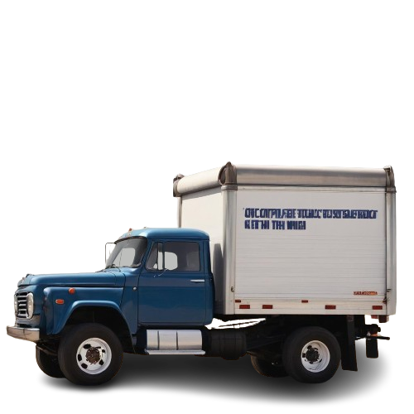
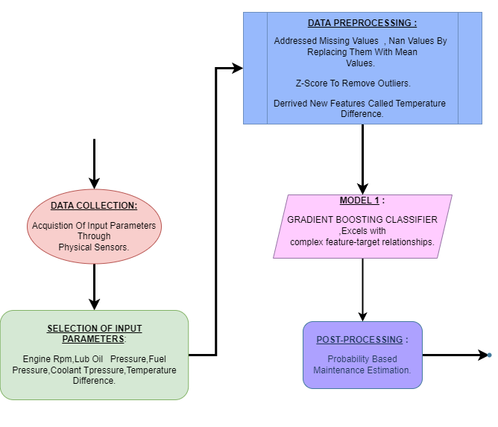
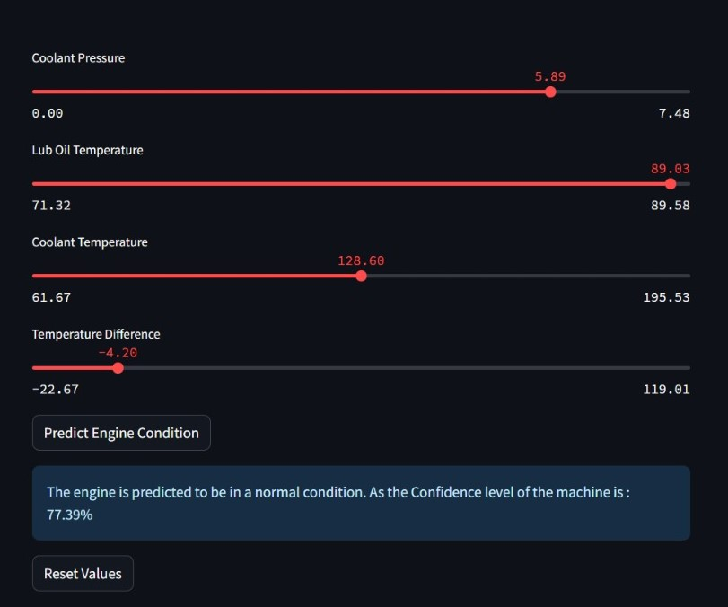
Proposed System

Slide 15
Gradient Boost Classifier
GBM is an ensemble learning method for regression and classification tasks.
It uses decision trees as base learners, typically shallow ones.
Trees are added sequentially, each correcting errors made by previous ones.
GBM minimizes loss function iteratively using gradient descent optimization.
Hyperparameters are tuned for optimal performance, and feature importance analysis provides insight into predictive factors.

Slide 16
Post-processing
Predicts maintenance probability based on model output.
Estimates maintenance date 2-3 weeks in advance.
Provides probability percentage for potential part failure.
Enhances predictive accuracy and allows proactive intervention.
Facilitates timely maintenance scheduling to minimize downtime.

Slide 17
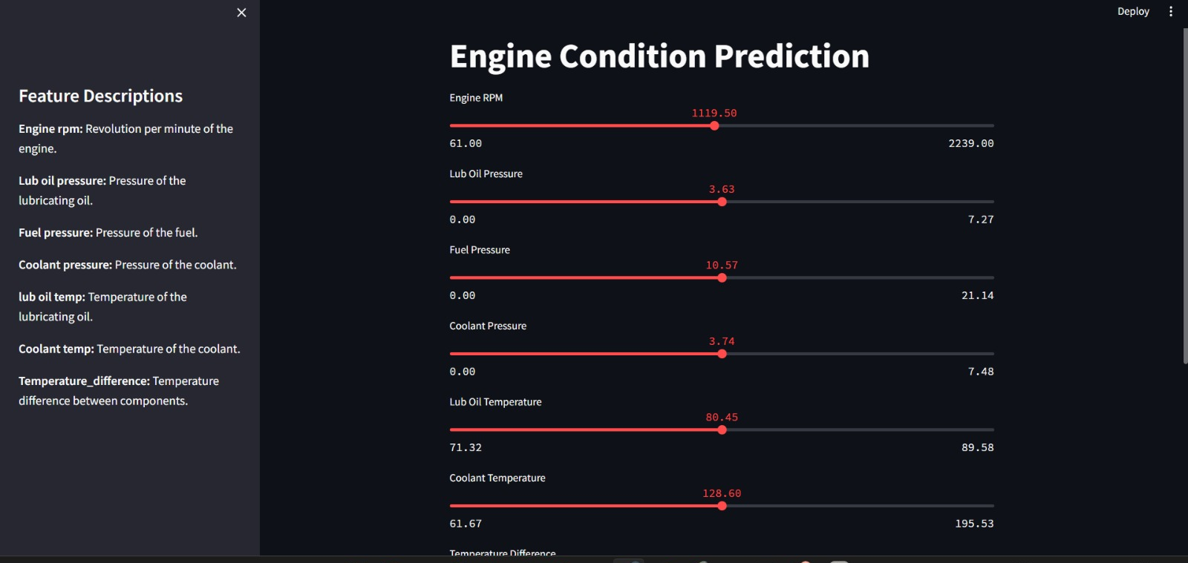
Result

Slide 18
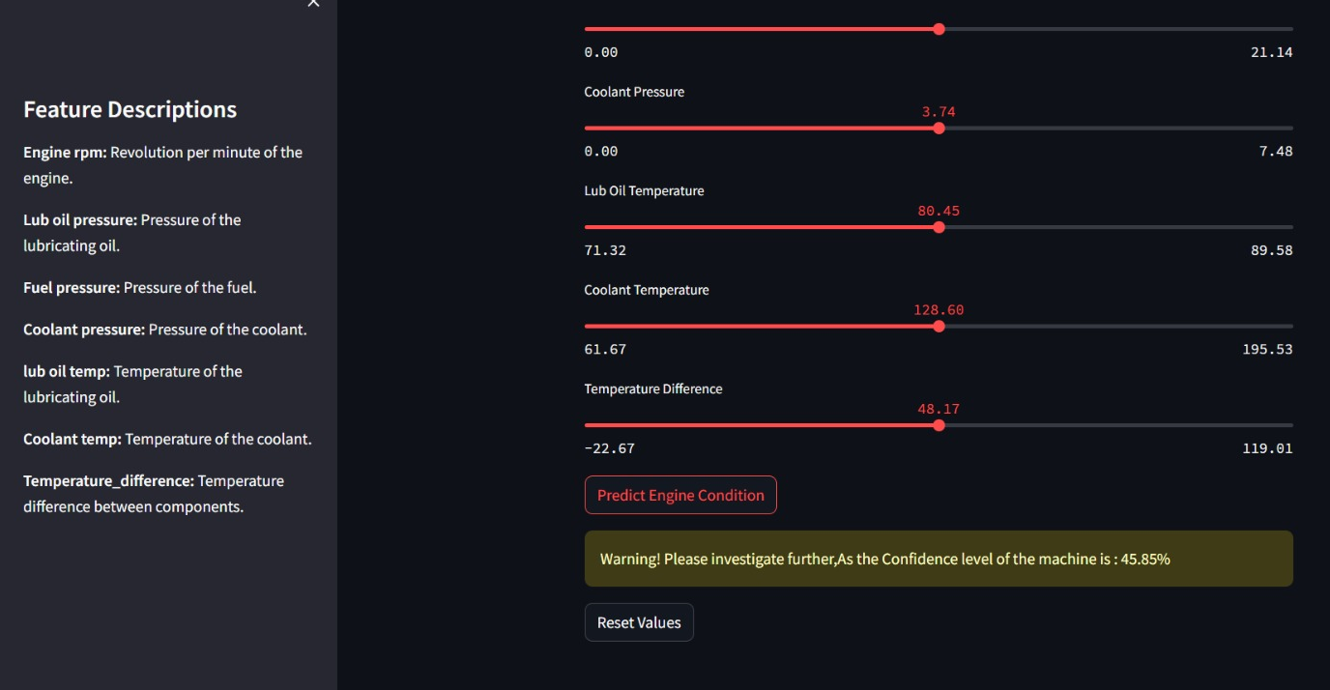
Result

Slide 19
Benefits
Performing maintenance time to time.
Optimizes resources and prevents emergency repairs before embarking on long journey.
Safety enhancements.
Enhancing supply chain efficiency and customer satisfaction.

Slide 20
Conclusion
In conclusion, our project revolutionizes transportation maintenance by proactively addressing issues before they disrupt operations.
By leveraging AI, we minimize downtime, cut costs, and boost vehicle reliability.
This ensures a seamless flow of produce, enhancing efficiency and safety for all stakeholders.

Slide 21
Thanks!!!

